Slide 1
Microsoft Azure
Einführung
IT Camp Hybrid IT
Peter Kirchner Technical Evangelist Microsoft Deutschland GmbH

Slide 2

Microsoft Azure
Portale
Management, Preview
PowerShell
Cmdlets
Xplat-CLI
SDKs
.Net, Java, PHP, Python
RESTful
direkt
RESTful Management API
Services
skalierbar
hochverfügbar
hybrid
offen
sicher
Microsoft Cloud Infrastruktur

Slide 3



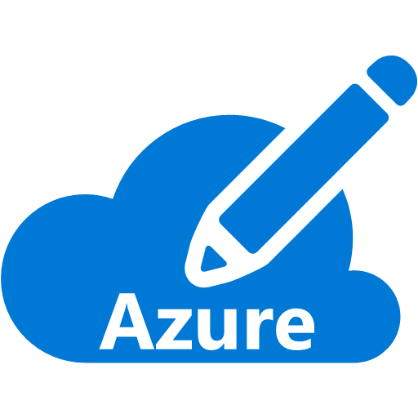
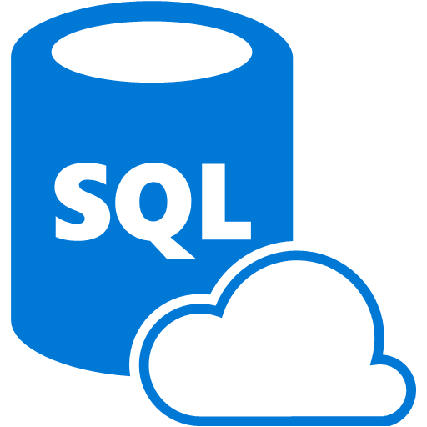



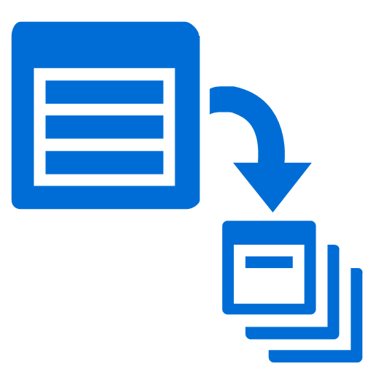


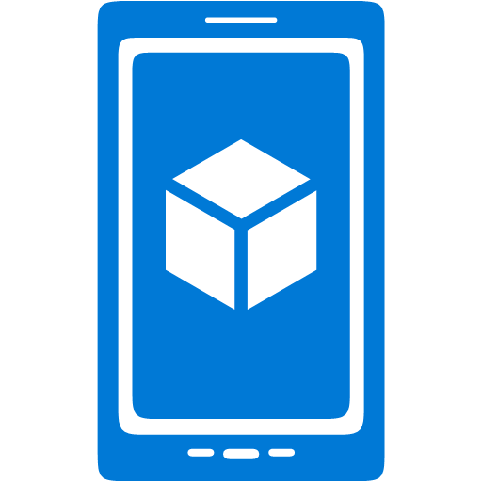




















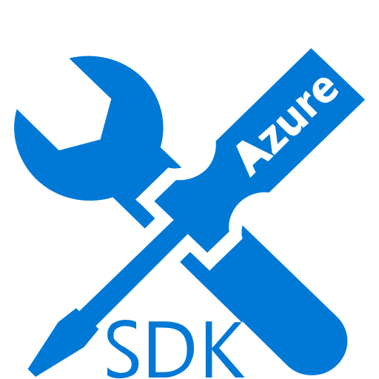



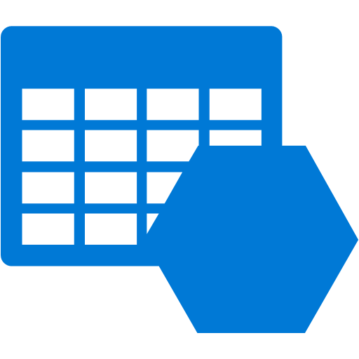









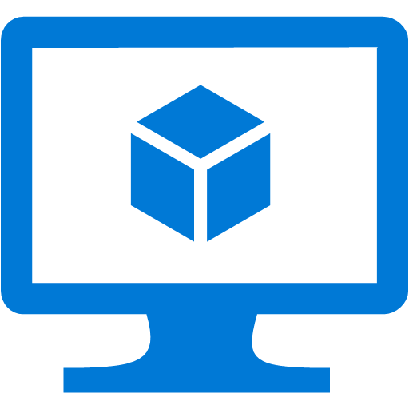








Platform Services
Security & Management
Services Compute
Web and Mobile
Data
Hybrid
Operations
Cloud
Services
Service
Fabric
Web Apps
API Apps
Portal
SQL
Database
Data
Warehouse
DocumentDB
Azure AD
Health Monitoring
Azure Active
Directory
Batch
RemoteApp
AD Privileged
Identity
Management
Mobile
Apps
Logic Apps
Redis
Cache
Azure
Search
Storage
Tables
Azure AD
B2C
Integration
Domain Services
Multi-Factor
Authentication
API
Management
Notification
Hubs
Storage
Queues
BizTalk
Services
Analytics & IoT
Backup
Automation
Hybrid
Connections
Service Bus
Developer Services
HDInsight
Machine
Learning
Stream
Analytics
Data
Lake
Operational
Analytics
Scheduler
Key Vault
Visual Studio
Azure
SDK
Data
Factory
Event
Hubs
Data
Catalog
Import/Export
Media & CDN
Store/
Marketplace
Media Services
Content Delivery
Network (CDN)
VS Online
App
Insights
Mobile
Engagement
Azure Site
Recovery
IoT Hub
VM Image Gallery
& VM Depot
StorSimple
Infrastructure Services
OS/Server Compute
Storage
Networking
Virtual Machines
Container
Service
BLOB Storage
Azure
Files
Premium
Storage
Virtual Network
Load Balancer
DNS
Express
Route
Traffic Manager
VPN Gateway
App
Gateway
Datacenter Infrastructure

Slide 4
Exkurs: Dienstmodelle
On-Premises
IaaS
PaaS
SaaS
Applications
Data
Users
Middleware
Operating System
Virtualization
Hardware
Networking
Physical Security
Customer
Provider

Slide 5
Exkurs: Cloud Computing nach NIST
National Institute of Standards and Technology
Special Publication 800-145 (2001)
Wesentliche Charakteristika
On-demand self-service
Broad network access
Resource pooling
Rapid elasticity
Measured service

Slide 6

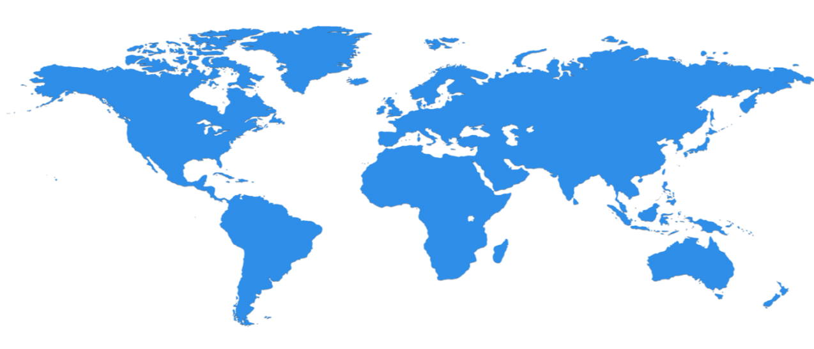

Hyper-Scale Infrastructure
28 Regionen weltweit, 22 online
North Central US
Illinois
United Kingdom
Regions
West Europe
Netherlands
Canada Central
Toronto
United Kingdom
Regions
Central US
Iowa
Canada East
Quebec City
Germany North East **
Magdeburg
US Gov
Iowa
China North *
Beijing
North Europe
Ireland
Germany Central **
Frankfurt
China South *
Shanghai
Japan East
Tokyo, Saitama
West US
California
East US
Virginia
India Central
Pune
Japan West
Osaka
South Central US
Texas
East US 2
Virginia
US Gov
Virginia
India South
Chennai
India West
Mumbai
East Asia
Hong Kong
SE Asia
Singapore
Australia East
New South Wales
Brazil South
Sao Paulo State
Australia South East
Victoria
100+ Rechenzentren
2.5x AWS, 7x Google DC Regions
G Series – Größte VM, 32 Kerne, 448 GB Ram, SSD …
Operational
Announced/Not Operational
* Operated by 21Vianet ** Operated by Deutsche Telekom

Slide 7
Speicher für (un-)strukturierte Daten
RDBMS in VM SQL
Oracle
MySql
SQL Database Basic
Standard Premium
DocumentDB
Table Storage
Blob Storage
Files
Disks & Drives
RDBMS
NoSQL (Dok)
NoSQL (K-V)
BLOB (Block/Page)
Filesystem
3-fach redundante Speicherung
TDS
RESTful
NTFS
Volle SQL Funktionalität
Maximale DB-Größe 16 TB
Auto-Setup und Clustering
Maximale DB-Größe 500GB
Objekt-Datenbank
Semi-strukturierte JSON-Objekte
NoSQL-DB
Große, semi-strukturierte Daten
Große Binärdaten (Videos, Bilder, Audio, …)
SMB File Share für VMs und Cloud Services
Basiert auf Blob-Storage
Persistentes FS für VMs und Cloud Services
Basiert auf Blob-Storage

Slide 8
Kapazität der IaaS-Speicherdienste
Azure Storage
Vier Speichertypen: Blobs, Files, Tables und Queues
Max 500 TB pro Storage Account
Kein Limit für die Anzahl an Blobs und File Shares
BLOBs
(Große) Binärdaten
Zwei Typen:
Block Blobs → max. ~195 GB Dateigröße
Page Blobs → max. 1 TB Dateigröße
Files
SMB File Share für VMs und Cloud Services
Max. 5 TB Daten pro File Share
Storage
BLOB
Storage
Azure
Files
Premium
Storage

Slide 9


Web Apps
Azure Loadbalancer
Anwender
Hosting klassischer Webseiten
Vorinstallierte Web-Frameworks möglich
Deployment über Code Repository möglich
Hintergrundprozesse via WebJobs
Verschiedene Leistungsstufen
Free
Basic (und höher):
Eigene Domain-Namen, Integrierter Loadbalancer
Standard:
Auto-Skalierung, Azure Scheduler, Staging Slots
Mehrere Skalierungsoptionen
Scale-Up und Scale-Out
Virtual Machine
Website Gallery
Web App
ASP.NET
PHP
Java
CMS
Blogs etc.
Application
Repository
VSO
GitHub
BitBucket
Dropbox
Internet Information Server (IIS)
Web Deploy
Submit
Lokale Entwicklungsumgebung

Slide 10

















Web Site Frameworks
etc.

Slide 11

Virtual Machines
Azure Loadbalancer
Anwender
Cloud Service /
Ressourcen-
gruppe
Virtual Machine
Hosting von Hyper-V-VMs
Gruppierung über Cloud Services & Ressourcengruppen
Lastbalancierte Endpunkte
Disks in VMs werden in Storage persistiert
Ausnahme: Local Disc (D:)
Alternativen für die Erstellung:
Erstellung eigener VMs (lokal)
Auswahl aus einer VM Gallery
Verbindung von VMs mit On-premises
über das Virtual Network
Mobilität der VMs
von On-Premises in die Cloud und zurück
Virtual Machine
Local Disc
Application
Schreib- Lese-Zugriffe
Images
Storage
Kopie in
Storage
Data VHD
OS VHD
Sysprep & Capture
Upload
Eigene VHD oder Image

Slide 12
Azure Resource Manager
Classic model (v1)
Resource Manager (v2)
Cloud service
Resource group
Load balanced
endpoint with IP address
Back-end pool (NICs)
VM with IP address
Storage account
VM
NIC
VM IP address
VNet
Load Balancer
LB IP address
Disk (blob)
Subnet
Reference
Reference
Reference
Virtual network
Reference
Storage account
Virtual network
Storage account
Depends on
Reference
Disk (blob)
Subnet-1
Network Security Group ACLS
(deployed to VM, NIC, or Subnet)

